Slide 1


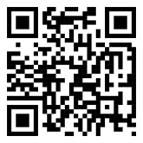

Twinning to Skyrocket Scientific Excellence Towards Individual Radiosensitivity Prediction by Raising the Bar in Knowledge Transfer, Networking, and Technological Innovation in Radiobiology
Lecture by Professor
Sarah Kerns
Medical College of Wisconsin, USA, titled:
“Genetic Risk Scores to Predict Late Radiation Toxicity in Prostate Cancer”
Sarah Kerns
Wednesday, August 27, 2025 at 12:15 CET
New Amphitheater in the Institute for Oncology and Radiology of Serbia
HORIZON-WIDERA 2023-ACCESS 02-01-Twinning Bottom-Up
Project ID 101158832

